Slide 1


Slide 2


Analysis of Cross Platform Binaries
PMAS-Arid Agriculture University- Rawalpindi University Institute of Information Technology
Anas bin Anwar 18-ARID-3007
Muhammad Mohsin Ali Babar 18-ARID-3028
Supervisor : Mr. Zeeshan Javed

Slide 3

Contents
Introduction
Existing System
Problem Statement
Problem Solution
Project Scope
Project Objective
Diagrams - Use case, Sequence, ERD
Tools and Technologies
Task Distribution
Screenshots
Future Project Schedule
University Institute of Information Technology, PMAS-Arid Agriculture University- Rawalpindi

Slide 4
Introduction
Binaries is a term used to refer to a particular set of executables or compiled computer programs files that will perform particular functions. Some binaries are malware which is used by attackers to perform malicious actions. Cross platform analysis is the process of analyzing a malware sample and be able to exfiltrate as much information as possible.
University Institute of Information Technology, PMAS-Arid Agriculture University- Rawalpindi

Slide 5
Existing System
There exists some existing system related to our project are as follows:
In Bitdefender,: had perfect results against all types of malware samples.
Window defender : show you notification and perform action agaist maleware
Avast :it is a free anti virus ,it detect, block and remove all type of maleware.
University Institute of Information Technology, PMAS-Arid Agriculture University- Rawalpindi

Slide 6
Problem Statement
Attackers are using malwares, Viruses, Trojan and spywares using binaries to perform particular functions and gain control over their targets or spying on them. Malware is sometimes used broadly against government or corporate website and systems to gather guarded information, or to disrupt their operations in general. However, malware can be used against individuals to gain information such as personal identification numbers or details, bank or credit card numbers, and passwords. We are developing cross system to detect malwares. Most of existing systems are not easy to use.Most of existing system are not userfriendly ,not give full detail what actually happened and some are paid.
University Institute of Information Technology, PMAS-Arid Agriculture University- Rawalpindi

Slide 7
Proposed Solution
Facilitate the public to secure data in time.
Show the status of device if user want to check.
Show detailed report against maleware .
Finally, user can easily check file , check url of any web page.
University Institute of Information Technology, PMAS-Arid Agriculture University- Rawalpindi

Slide 8
Project Scope
By using this system, user can avoid the loss. It is difficult for user to understand the complex tool, so they can use this application with ease. The system show a graph to user where system tell the user about malicious attacks information. System will generate auto report monthly about malicious attacker if user have account and get online daily. We use different techniques for malicious attacks analysis, e.g static analysis techniques, dynamically analysis technique, memory analysis. We use different python libraries for this project scapy, cryptography etc.
University Institute of Information Technology, PMAS-Arid Agriculture University- Rawalpindi

Slide 9
Project Objectives
Easy to use and user friendly.
2) To analyze all types of binaries malware attacks.
3) To infiltrate maximum amount of information.
4) Give tips and tricks against attackers.
5) To analyze cross platform malwares.
University Institute of Information Technology, PMAS-Arid Agriculture University- Rawalpindi

Slide 10
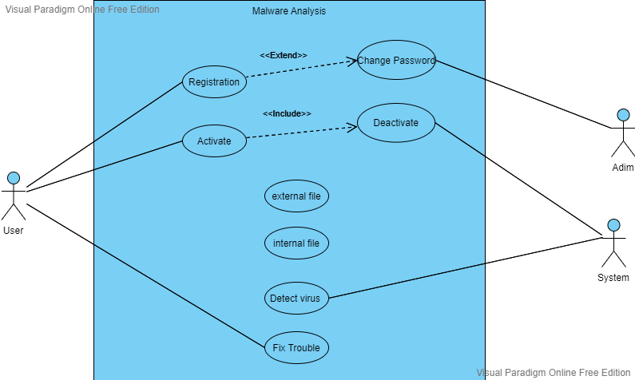
Diagrams -Use Case Diagram
University Institute of Information Technology, PMAS-Arid Agriculture University- Rawalpindi

Slide 11
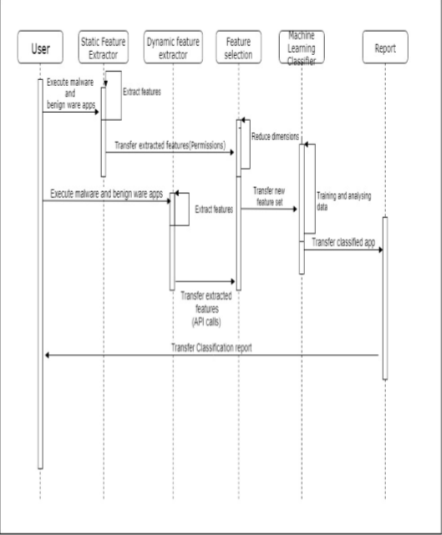
Diagrams –Sequence Diagram
University Institute of Information Technology, PMAS-Arid Agriculture University- Rawalpindi

Slide 12
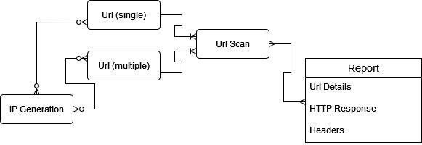
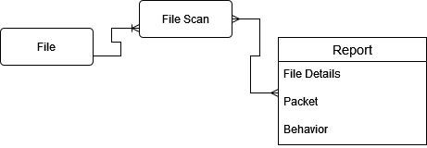
Diagrams –ERD
University Institute of Information Technology, PMAS-Arid Agriculture University- Rawalpindi

Slide 13
Tasks Distribution
Group Members | Responsibilities
Anas Bin Anwer | Data base connection Python coding, flask coding, python libraries
Mohsin Ali Baber | .Introduction, Project propose, Function and Non-functional Requirements
University Institute of Information Technology, PMAS-Arid Agriculture University- Rawalpindi

Slide 14

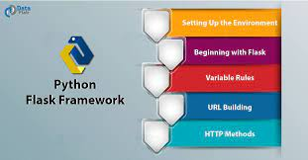
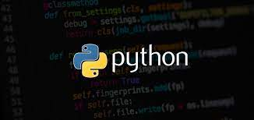

Tools & Technologies
University Institute of Information Technology, PMAS-Arid Agriculture University- Rawalpindi

Slide 15
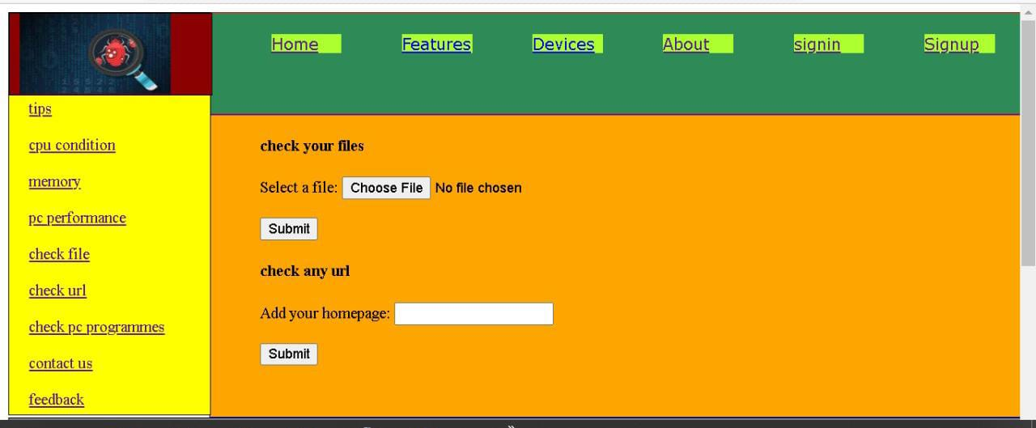
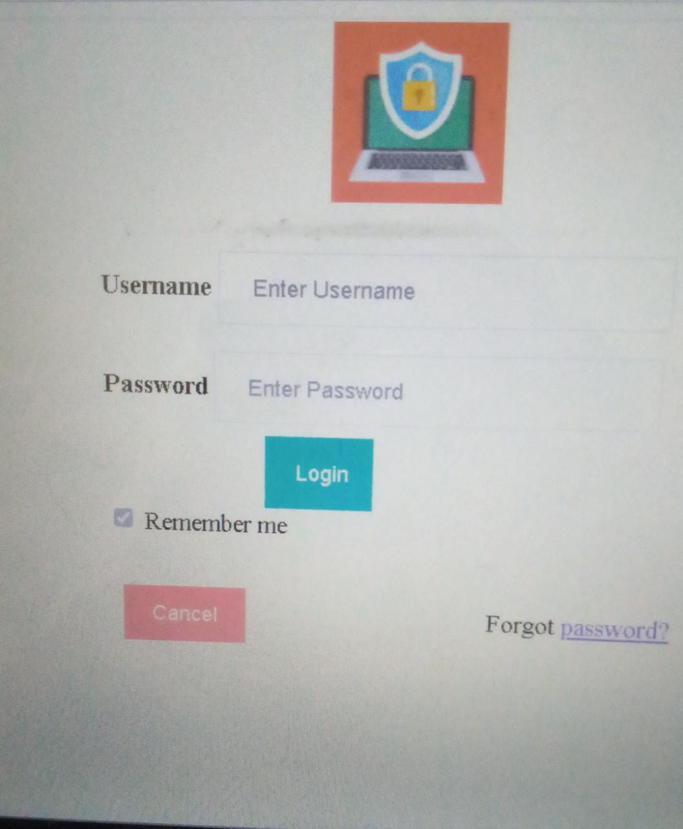
Screen Shots
University Institute of Information Technology, PMAS-Arid Agriculture University- Rawalpindi

Slide 16
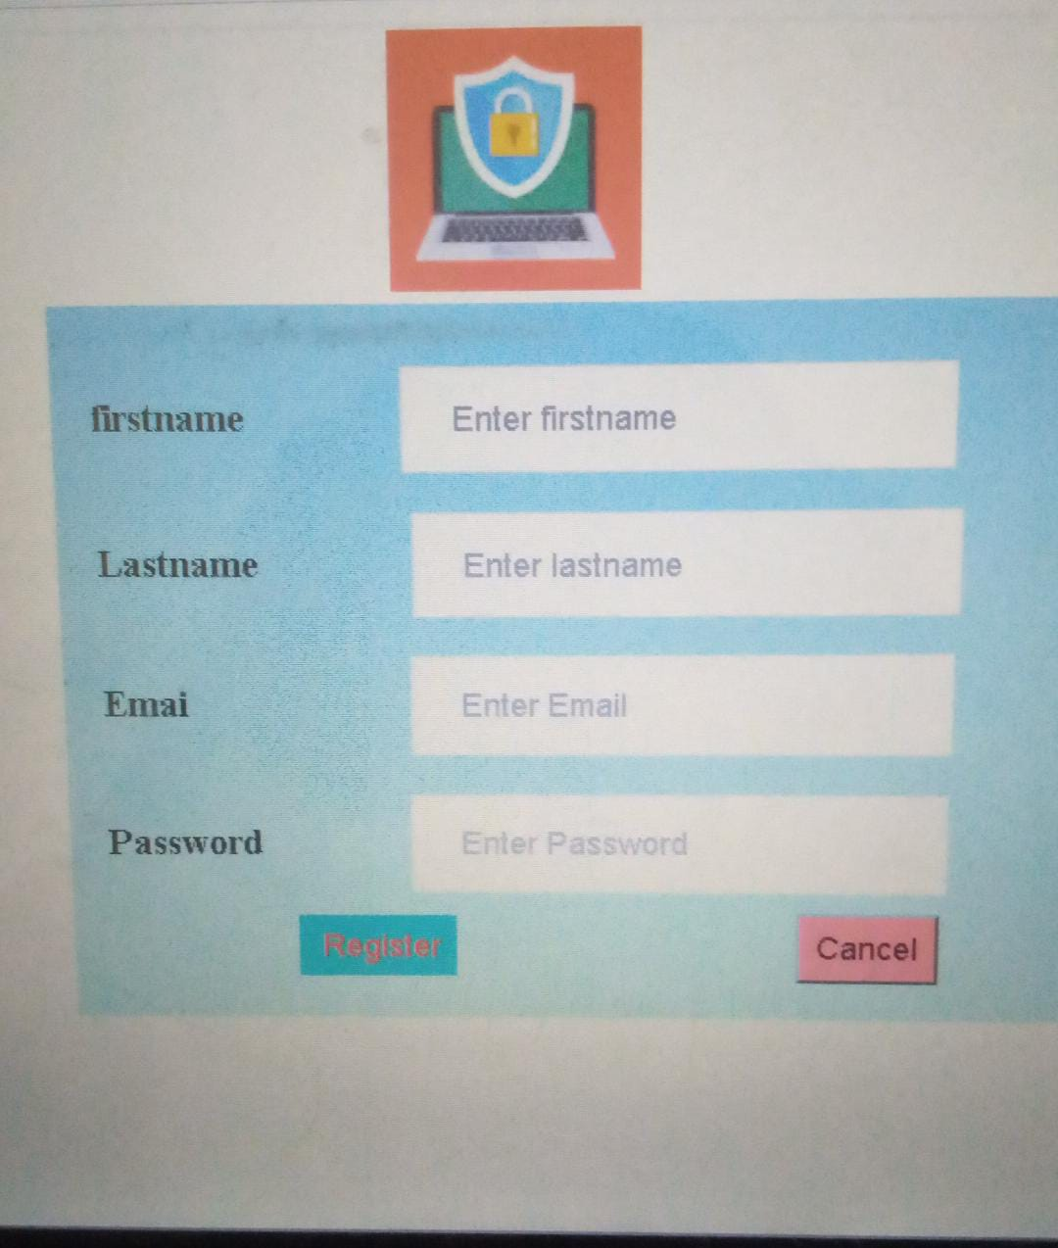
Screen Shots
University Institute of Information Technology, PMAS-Arid Agriculture University- Rawalpindi

Slide 17
Future Project Schedule
Update this List as per Your Supervisor Guidelines
Tasks | Schedule
Design & Coding of Project Python script Flask coding Backend coding | 10th February To 30 april 2022
Creating Reports | 1st may to 10th may 2022
Testing of Project Module wise & Finishing the Code | 10th may To 15th 2022
Integrating Project | 15st May 2022 To 20th May 2022
Testing of Project | 21st May To Finsih Date
University Institute of Information Technology, PMAS-Arid Agriculture University- Rawalpindi

Slide 18


